Slide 1
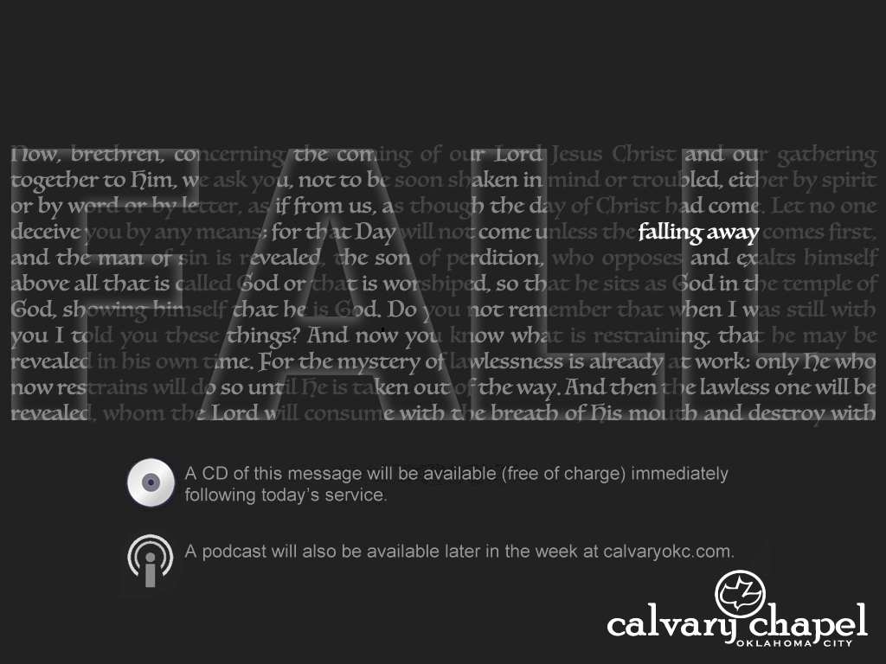
2 Thessalonians 3:1-18

Slide 2
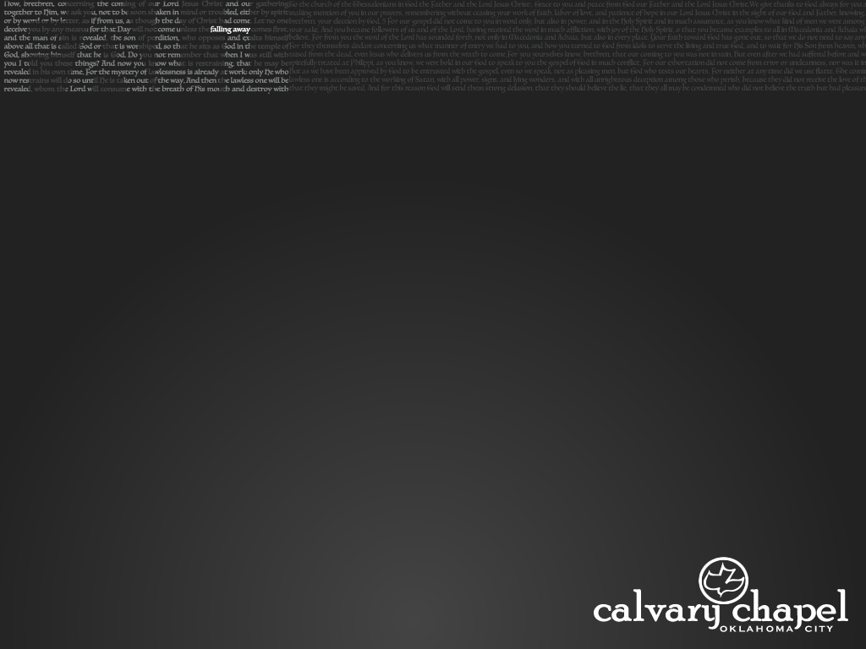
¹ Finally, brethren, pray for us, that the word of the Lord may run swiftly and be glorified, just as it is with you, ² and that we may be delivered from unreasonable and wicked men; for not all have faith.
³ But the Lord is faithful, who will establish you and guard you from the evil one. ⁴ And we have confidence in the Lord concerning you, both that you do and will do the things we command you.
⁵ Now may the Lord direct your hearts into the love of God and into the patience of Christ.
2 Thess. 3:1-18 ~
2 Thessalonians 3:1-18

Slide 3
⁶ But we command you, brethren, in the name of our Lord Jesus Christ, that you withdraw from every brother who walks disorderly and not according to the tradition which he received from us. ⁷ For you yourselves know how you ought to follow us, for we were not disorderly among you; ⁸ nor did we eat anyone’s bread free of charge, but worked with labor and toil night and day, that we might not be a burden to any of you, ⁹ not because we do not have authority, but to make ourselves an
2 Thess. 3:1-18 ~
2 Thessalonians 3:1-18

Slide 4
example of how you should follow us.
¹⁰ For even when we were with you, we commanded you this: If anyone will not work, neither shall he eat. ¹¹ For we hear that there are some who walk among you in a disorderly manner, not working at all, but are busybodies. ¹² Now those who are such we command and exhort through our Lord Jesus Christ that they work in quietness and eat their own bread.
2 Thess. 3:1-18 ~
2 Thessalonians 3:1-18

Slide 5
¹³ But as for you, brethren, do not grow weary in doing good. ¹⁴ And if anyone does not obey our word in this epistle, note that person and do not keep company with him, that he may be ashamed. ¹⁵ Yet do not count him as an enemy, but admonish him as a brother.
¹⁶ Now may the Lord of peace Himself give you peace always in every way. The Lord be with you all.
¹⁷ The salutation of Paul with my own hand, which is a sign in every epistle; so I write.
2 Thess. 3:1-18 ~
2 Thessalonians 3:1-18

Slide 6
¹⁸ The grace of our Lord Jesus Christ be with you all. Amen.
2 Thess. 3:1-18 ~
2 Thessalonians 3:1-18

Slide 7
2 Thessalonians 3:1-18

Slide 8
may run swiftly ~ trechō – trek
glorified ~ NIV, honored
2 Thessalonians 3:1-18

Slide 9
2 Thessalonians 3:1-18

Slide 10
Claims the Bible makes
Verifiable
Non-verifiable
With EVERY archaeological find, the vertical line is ALWAYS moving to the right. Never has it ever moved left.
2 Thessalonians 3:1-18

Slide 11
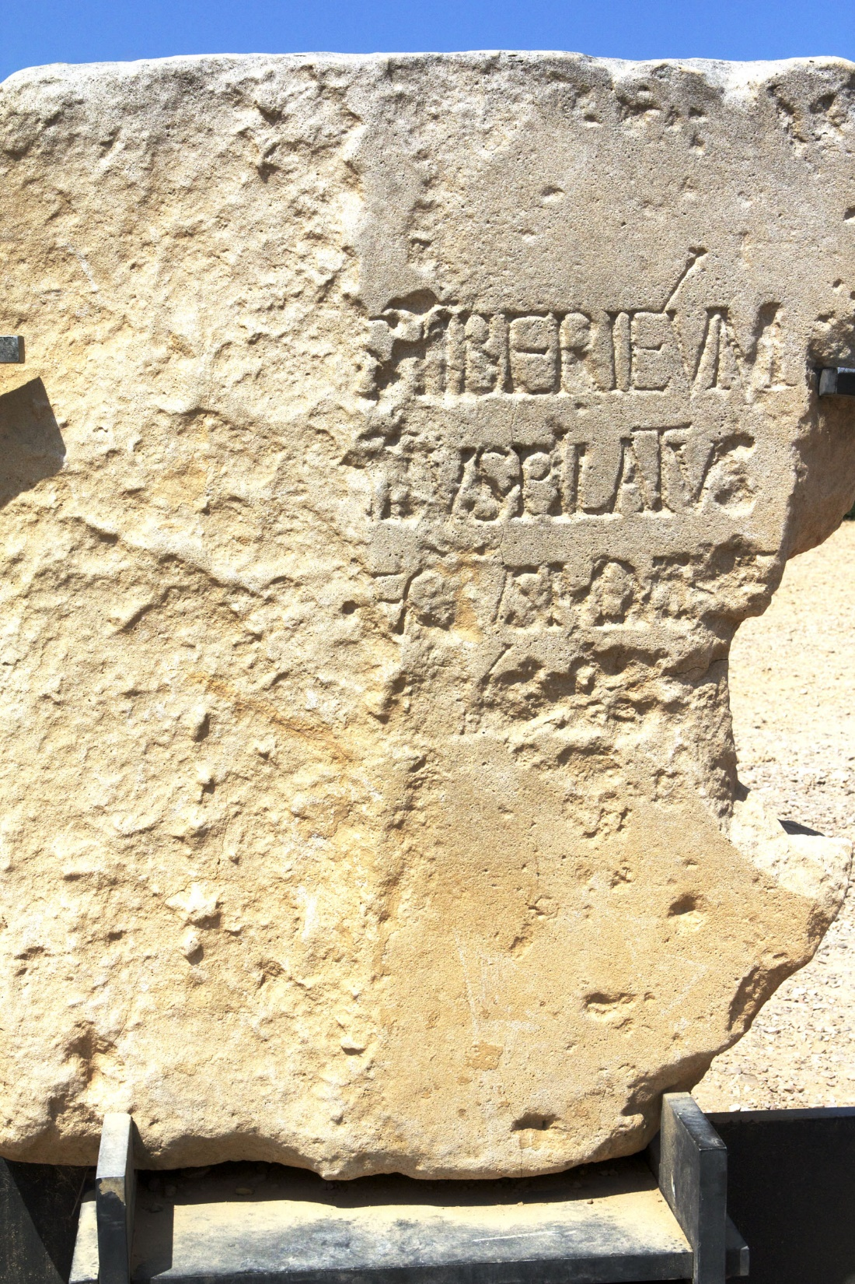
Pilate stone
discovered 1961
2 Thessalonians 3:1-18

Slide 12
Ps. 12:6 ~ The words of the Lord are pure words, Like silver tried in a furnace of earth, Purified seven times.
Ps. 138:2 (NASB) ~ I will bow down toward Your holy temple And give thanks to Your name for Your lovingkindness and Your truth;
For You have magnified Your word according to all Your name.
2 Thessalonians 3:1-18

Slide 13
2 Thessalonians 3:1-18

Slide 14
Ps. 119:9 ~ How can a young man cleanse his way? By taking heed according to Your word.
2 Thessalonians 3:1-18

Slide 15
C. H. Spurgeon ~ “Suppose a number of persons were to take it into their heads that they had to defend a lion, a full-grown king of beasts! There he is in the cage, and here come all the soldiers of the army to fight for him. Well, I should suggest to them, if they would not object, and feel that it was humbling to them, that they should kindly stand back, and open the door, and let the lion out!
2 Thessalonians 3:1-18

Slide 16
C. H. Spurgeon ~ I believe that would be the best way of defending him, for he would take care of himself; and the best ‘apology’ for the gospel is to let the gospel out. Never mind about defending Deuteronomy or the whole of the Pentateuch; preach Jesus Christ and him crucified. Let the Lion out, and see who will dare to approach him. The Lion of the tribe of Judah will soon drive away all his adversaries.”
2 Thessalonians 3:1-18

Slide 17
2 Thessalonians 3:1-18

Slide 18
unreasonable ~ atopos – not in place, out of place
2 Thessalonians 3:1-18

Slide 19
2 Thessalonians 3:1-18

Slide 20
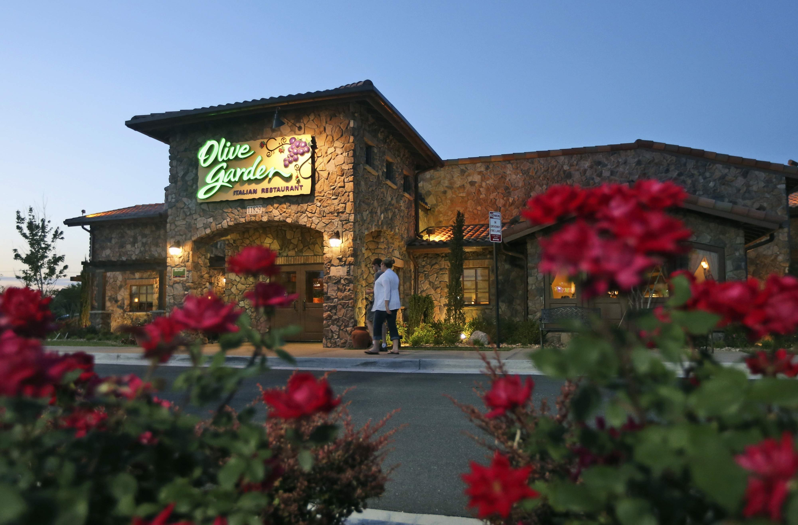
establish ~ stērizō – to make strong, solid
guard ~ to watch over or preserve
From a root meaning family
When you’re here …
you’re family
2 Thessalonians 3:1-18

Slide 21
2 Thessalonians 3:1-18

Slide 22
direct ~ kateuthunō – to fully straighten
2 Thessalonians 3:1-18

Slide 23


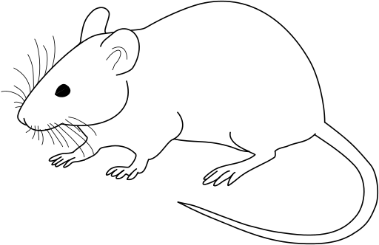
Where I want to go
My present spiritual state
Love of God;
Patience in Christ
Where I am
2 Thessalonians 3:1-18

Slide 24
Charles Swindoll ~ “He entreats the Lord to direct their hearts into love and endurance. In the in intense storms of persecution and affliction, which are ultimately stirred by the evil one, steadfast hearts are harbored in a deep love for God. In reality, it is not the intensity of the storms washing over our lives that shipwrecks us, but the lack of intensity in our love for God. Our love for Him forms the sturdy mast and mainsail of our lives.”
2 Thessalonians 3:1-18

Slide 25
2 Thessalonians 3:1-18

Slide 26
disorderly ~ ataktos – out of position
Middle of the 1st century it had the meaning of idleness
2 Thessalonians 3:1-18

Slide 27
2 Thessalonians 3:1-18

Slide 28
“You shall not muzzle an ox while it treads out
Deut. 25:4 ~
1 Tim. 5:18 ~
1 Cor. 9:9 ~
the grain.”
the grain.”
and, “The laborer is worthy of his wages.”
Is it oxen God is concerned about?
Matt. 10:10 ~ nor bag for your journey, nor two tunics, nor sandals, nor staffs; for a worker is worthy of his food.
2 Thessalonians 3:1-18

Slide 29
2 Thessalonians 3:1-18

Slide 30
busybodies ~ periergazomai – around + work
2 Thessalonians 3:1-18

Slide 31
2 Thessalonians 3:1-18

Slide 32
admonish ~ to put in the mind
2 Thessalonians 3:1-18

Slide 33
2 Thessalonians 3:1-18

